Slide 1
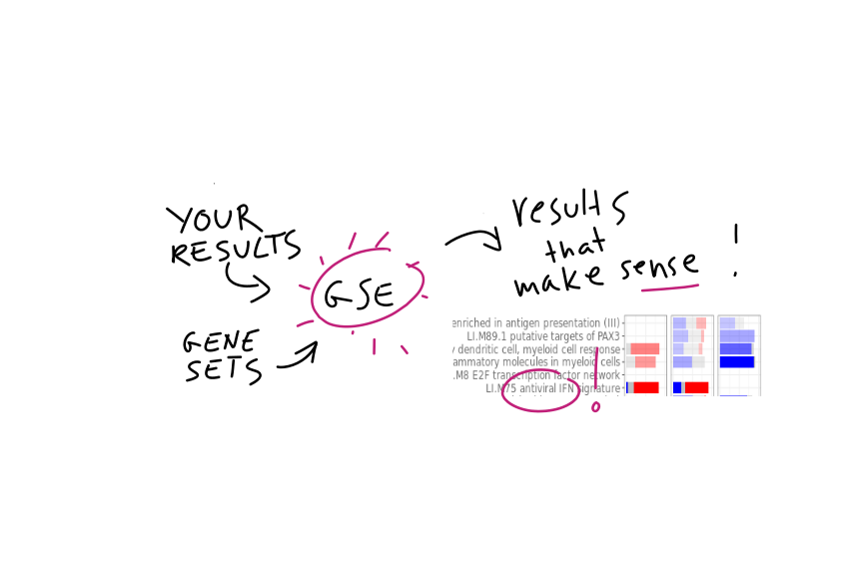
The insidious trappings of gene set enrichments
January.Weiner@bih-charite.de
Core Unit for Bioinformatics

Slide 2
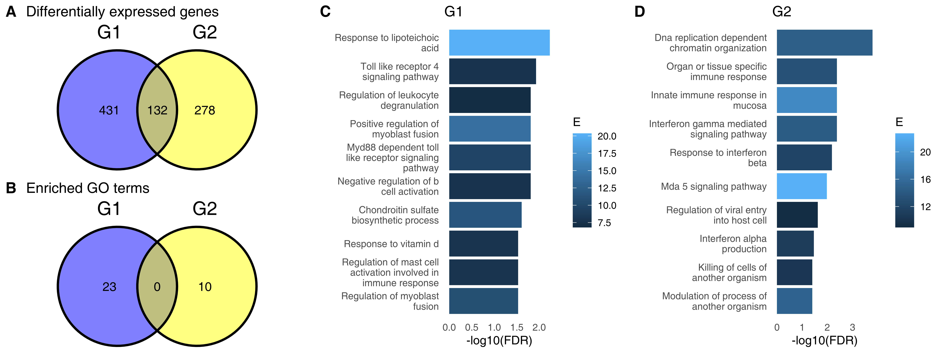
"The difference between “significant” and “not significant” is not itself statistically significant"
– Andrew Gelman and Hal Stern
Core Unit for Bioinformatics

Slide 3

Out of 282 papers analysed, 88 (31%) were incorrect.
Beware of Venn diagrams
Do not compare significant with non-significant
Beware of false positives
Do not use gene-based randomization tests
January.weiner@bih-charite.de
Cubi.bihealth.org
Github:january3/presentation-icsb-2022
Core Unit for Bioinformatics

